Slide 1
PEGA Decisioning Essentials

Slide 2
Agenda – Session 4
Introduction to Business Taxonomy
Configuring Business Issue
Configuring Business Group
Adding Propositions

Slide 3
Business Taxonomy
a
s
Business Taxonomy is a business structure that composes of the components/services/products business want to promote and market to their target audience.
This taxonomy comprises of below components.
Issue
Group
Proposition
Web Coding
Globalization
I
i
Big Basket
Trolly Boy
J
Price Tag

Slide 4
Configuring Business Taxonomy
Navigate to Configure > Decisioning > Decisions > Proposition Management > Hierarchy
Now Click on Add > Issue
ISSUE – This is the business purpose. i.e the reason for promotion. For ex – Acquisition, Retention, Maintanence
GROUP – This is the promotion category i.e the category of promotions. For ex – Credit Cards, Mobiles, Tshirts
Propositions – Promotion itself. For ex – 16GB RAM Iphone, No EMI Credit Card, Free Coupon, 20% Discount Tshirt

Slide 5
Configuring Business Taxonomy
BUSINESS ISSUE
---- BUSINESS GROUP
----- PROPOSITION
------ Properties (Attributes)

Slide 6
Proposition Attributes
Attributes are characteristics of propositions such as price of a product like saleprice, discount offered like discount
These are applied at SR Level (Top level) applied to all issues/groups
Can also be applied at Decision Data level (applied to all propositions in a business group)
Lets now configure the proposition attributes at both levels.

Slide 7
Importing Propositions

Slide 8
Propositions
Propositions that are the promotion itself. It can a service/product/coupon/discount anything offered to customer.
Create all required proposition attributes before uploading the proposition.
We can import large number of propositions using IMPORT button.
Export and create a CSV template with list of OOTB properties.
Manually add 4-5 propositions.
Upload the CSV & Verify updated Decision Data.

Slide 9
Strategy Result (SR Class)
SR Class (Strategy Result class) is auto created when atleast one business issue is configured.
Structure follows similar to work group
ApplicationID-SR-Issue-Group
All decision rules configured available under SR class.
Every SR class should directly inherit from Data-pxStrategyResult

Slide 10
Recap

Slide 11
NBAD Template
Now that we have configured the below items.
Configured Context Dictionary.
Imported CAR Data Model.
Imported NBAA Template
Defined Business Structure.
Configured Propositions & their attributes.
Let us look into configuring a basic strategy with simple strategy components.

Slide 12
Basic Strategy

Slide 13
Strategy Configuration
A Strategy is a critical decisioning module that allows decisioning consultants to configure effective business logic that will result in NBA.
Business Logic can be configured within the strategy using strategy canvas.
It contains of various components.
Strategy Execution happens from left to right.
Generally, the applies-to-class for strategies are configured under SUBJECT class

Slide 14
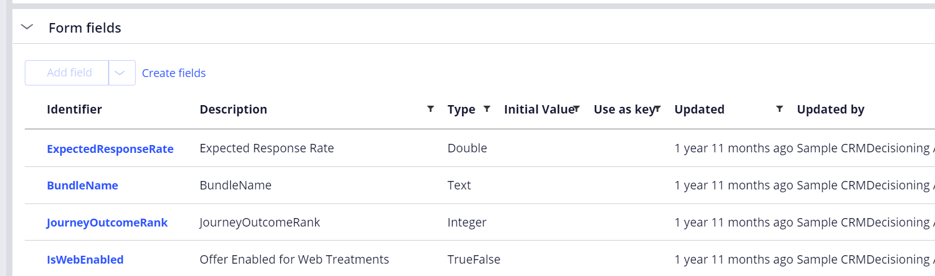
Auto Generated Form
Whenever we create a decision data, we can add custom fields in the FORM tab.
However, we cannot create advanced controls such as dropdown, radiobutton, checkbox etc.
We can do the same from the CUSTOM FORM. i.e pyEditElement

Slide 15
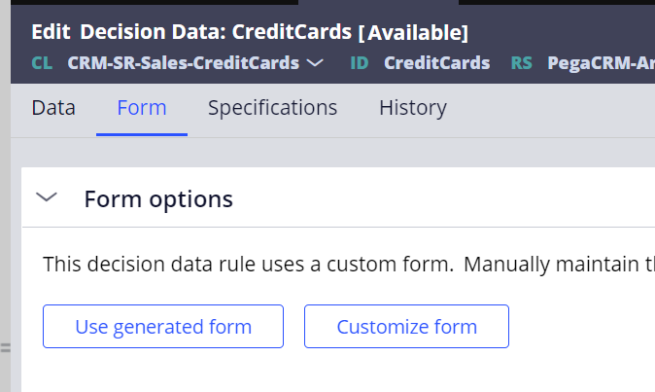
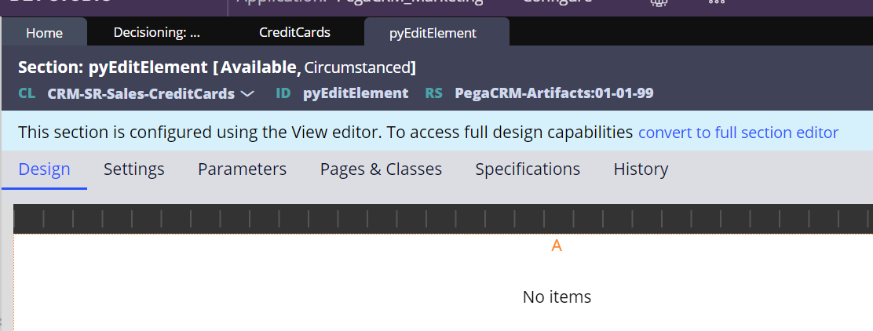
Using Custom Form
Custom Form allows to configure the decision data with all advanced controls such as Link, Dropdown, Checkbox etc within the proposition form.
Now click on Customize Form button inorder to configure the attributes.
We can configure all custom attributes within the pyEditElement.
Advantage is we can configure this section in top level SR class or use properties from other SR class.

Slide 16
Strategy Shapes
Lets examine the below simple scenarios this session
Importing Propositions
Filtering Propositions
Setting Attributes.
Using Annotations
Using Switch Component
Using Champion Challenger
Using Prioritize Component
We also be covering how do we test the strategies using customer persona.
2. Now , provide the applies to class as primary context class.

Slide 17
Questions!

